Slide 1
TEALS Minecraft Project
Lecture 6: Basic Entities

Slide 2
A New Minecraft Object: Entities
So far, you've learned about two different kinds of Minecraft objects: items and blocks. For the rest of this project, you'll work with entities.
Entities Have Unique State
Each entity instance has its own state (health, items, damage, and so forth)
Even items are a type of entity (EntityItem)
Notes:
Unlike blocks, each entity instance has its own unique state. This allows entities to roam around the Minecraft world, to take damage, to carry items, and so forth.
In fact, technically Items are actually entities (EntityItem). You can even program entities to wander the map themselves (like a sword that attacks players on its own)!

Slide 3
Entity Basics – Entity Hierarchy
Entity
EntityLiving
EntityCreature
EntityAgeable
EntityMob
EntityFlying
EntityAnimal
Robot
Robot
EntityTameable
Notes:
Here's a small portion of the entity hierarchy. We'll be focusing on the center portion, which ultimately derives from EntityRobot.

Slide 4
Entity Basics – Entity Hierarchy
Entity
EntityLiving
EntityCreature
EntityAgeable
EntityMob
EntityFlying
EntityAnimal
Robot
EntityTameable
Notes:
Entity is the base class for all entities.

Slide 5
Entity Basics – Entity Hierarchy
Entity
EntityLiving
EntityCreature
EntityAgeable
EntityMob
EntityFlying
EntityAnimal
Robot
EntityTameable
Notes:
Every EntityLiving instance has specific tasks that give it lifelike attributes.
Almost every entity that moves around the Minecraft map derives from EntityLiving.

Slide 6
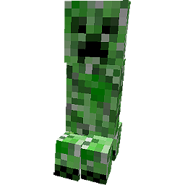
Entity Basics – Entity Hierarchy
Entity
EntityLiving
EntityCreature
EntityAgeable
EntityMob
EntityFlying
EntityAnimal
Robot
EntityTameable
Notes:
An EntityCreature is an entity that can move and may attack.
Creature shown is a "creeper".
For example, creepers will follow a player and will explode when they get close enough to do damage.

Slide 7
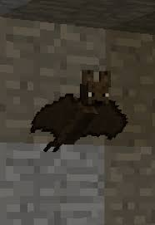
Entity Basics – Entity Hierarchy
Entity
EntityLiving
EntityCreature
EntityAgeable
EntityMob
EntityFlying
EntityAnimal
Robot
EntityTameable
Notes:
EntityFlying is an entity that can fly around the world.
For example, bats spawn in dark places and fly around (that's pretty much it).

Slide 8
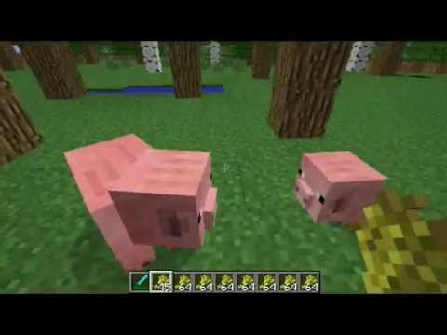
Entity Basics – Entity Hierarchy
Entity
EntityLiving
EntityCreature
EntityAgeable
EntityMob
EntityFlying
EntityAnimal
Robot
EntityTameable
Notes:
An EntityAgeable creature can be a baby or an adult.
For example, pigs and cows start out as babies and then grow to full-sized adults.

Slide 9
Entity Basics – Entity Hierarchy
Entity
EntityLiving
EntityCreature
EntityAgeable
EntityMob
EntityFlying
EntityAnimal
Robot
EntityTameable
Notes:
An EntityAnimal can reproduce.

Slide 10
Entity Basics – Entity Hierarchy
Entity
EntityLiving
EntityCreature
EntityAgeable
EntityMob
EntityFlying
EntityAnimal
Robot
EntityTameable
Notes:
Animals that can be tamed by a player are of the class EntityTameable.

Slide 11
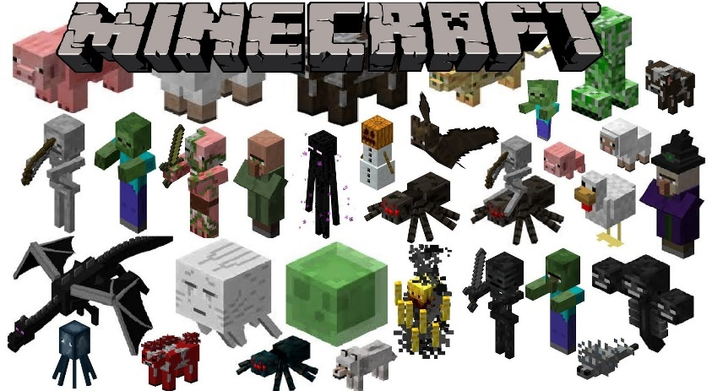
Entity Basics – Entity Hierarchy
Entity
EntityLiving
EntityCreature
EntityAgeable
EntityMob
EntityFlying
EntityAnimal
Robot
EntityTameable
Notes:
An EntityMob creature has advanced attack behavior, like being able to handle weapons and other advanced tasks.
Some of these creatures (like skeletons or zombies) burn in the sunlight.
In addition, entities that derive from EntityMob have advanced pathfinding capabilities, which means that they can figure out how to navigate from where they are to a spot they want to get to.
Pictured are entities that derive from EntityMob. Although, not all of them derive from EntityMob.

Slide 12
Entity Basics – Entity Hierarchy
Entity
EntityLiving
EntityCreature
EntityAgeable
EntityMob
EntityFlying
EntityAnimal
Robot
EntityTameable

Slide 13
Entity Basics – Entity Hierarchy
Entity
EntityLiving
EntityCreature
EntityAgeable
EntityMob
EntityFlying
EntityAnimal
Robot
EntityTameable
Notes:
EntityRobot is the base class for entities that you will create for the remaining labs.
More details about EntityRobot to come later in this lecture.

Slide 14
EntityAITasks
Notes:
EntityLiving entities contain a field of type EntityAITasks (named 'tasks').
EntityAITask is used to add behaviors to an entity.
An EntityLiving entity can have as many tasks as it wants.

Slide 15
EntityAITasks
Add behaviors to EntityLiving entities
Notes:
EntityLiving entities contain a field of type EntityAITasks (named 'tasks').
EntityAITask is used to add behaviors to an entity.
An EntityLiving entity can have as many tasks as it wants.

Slide 16
EntityAITasks
Add behaviors to EntityLiving entities
Derive from EntityAIBase
Notes:
EntityLiving entities contain a field of type EntityAITasks (named 'tasks').
EntityAITask is used to add behaviors to an entity.
An EntityLiving entity can have as many tasks as it wants.

Slide 17
EntityAITasks
Add behaviors to EntityLiving entities
Derive from EntityAIBase
Run with a specified priority
Notes:
EntityLiving entities contain a field of type EntityAITasks (named 'tasks').
EntityAITask is used to add behaviors to an entity.
An EntityLiving entity can have as many tasks as it wants.

Slide 18
EntityAITasks
Add behaviors to EntityLiving entities
Derive from EntityAIBase
Run with a specified priority
Are named EntityAIXXX, where XXX is the description of the task
Notes:
EntityLiving entities contain a field of type EntityAITasks (named 'tasks').
EntityAITask is used to add behaviors to an entity.
An EntityLiving entity can have as many tasks as it wants.

Slide 19
EntityAITasks
Add behaviors to EntityLiving entities
Derive from EntityAIBase
Run with a specified priority
Are named EntityAIXXX, where XXX is the description of the task
Example Tasks
EntityAIWander — move from current location to a random spot occasionally
EntityAIPanic — run around frantically for a period of time
EntityAIFleeSun — try to move to a darker spot
EntityAIWatchClosest — look at closest nearby entity
EntityAIAvoidEntity — avoid another entity
EntityAIEatGrass — find grass. Eat grass.
Notes:
EntityLiving entities contain a field of type EntityAITasks (named 'tasks').
EntityAITask is used to add behaviors to an entity.
An EntityLiving entity can have as many tasks as it wants.

Slide 20
The Game Loop
All tasks are executed in the "game loop".
The Minecraft game loop runs 20 times every second. Thus, one Minecraft "tick" is 50ms (50 milliseconds) long.
In one tick, every animated thing in Minecraft is updated.
Notes:
In one tick, entities figure out their next step, grass spreads, skeletons check surrounding light levels, objects in flight move a bit, mine carts move forward a bit, the sun and clouds move in the sky, and so forth.

Slide 21
The Game Loop
If all tasks finish before the tick is over (less than 50ms), the game sits idle until the tick is done.
If all tasks take longer than 50ms to complete, then the world slows down as it struggles to get all the work done. Hopefully this rarely happens.
The game can address this situation by doing one of two things:
Reduce the number of entities and blocks loaded at any time
Increase the performance of the task code
This is why you often see the world fade in and out in the distance — the game is managing how many things it has to keep track of at the same time.
Notes:
You could mention that "the game sits idle" is typically accomplished by making a call to an operating system function that doesn't return until some specified time. Once the time is up (when the next tick is ready to start), the operating system function returns and the Minecraft code immediately begins executing the next tick.
Contrary to popular belief, adding lots of players in a world doesn't slow the game down much, as processing players is not very computationally expensive.

Slide 22
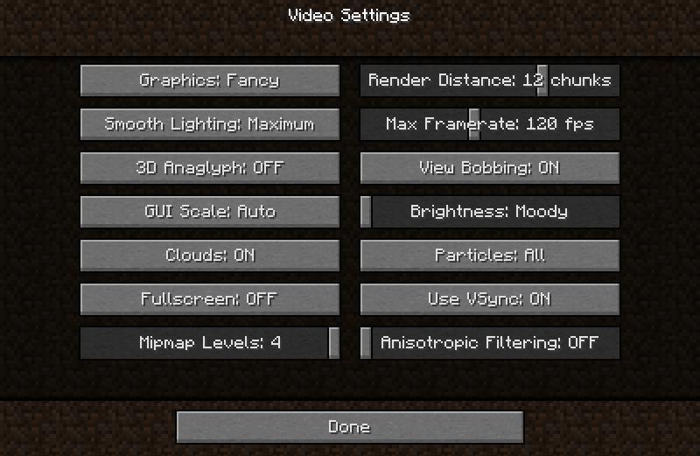
The Game Loop
You can adjust some of the Minecraft world workload by starting up the game, and going into options, then video settings. How can changing these settings reduce the work done in a single tick?
Notes:
Changing the graphics level changes how long it will take to render the resulting world after a tick.
Reducing the lighting smoothness reduces the work need to render.
Turning clouds off eliminates the need to animate and render them.
Render distance changes how many chunks of the world are in view and active at one time.
Changing the particle count affects how many particles all around the world are generated, managed, animated, and rendered.
NOTE: This is a good place to go to if Minecraft runs slowly on their machines.

Slide 23
EntityAITask Functions
EntityAITask classes have four primary methods to implement:
// Returns true if the task should be executed.
public boolean shouldExecute();
// Called when the task begins execution.
public void startExecuting();
// Returns true if an already-executing task should continue.
public boolean continueExecuting();
// Called once per tick (20 times per second)
public void updateTask();

Slide 24
EntityAITask CODE
package tealsmc.anything;
import net.minecraft.entity.EntityLiving;
import net.minecraft.entity.ai.EntityAIBase;
public class EntityAIExampleTask extends EntityAIBase {
private EntityLiving entity; // Target Entity
public EntityAIExampleTask (EntityLiving entity) {
this.entity = entity;
}
@Override
public boolean shouldExecute() {
// This abstract method must be implemented.
return true;
}
}

Slide 25
EntityAITask CODE
package tealsmc.anything;
import net.minecraft.entity.EntityLiving;
import net.minecraft.entity.ai.EntityAIBase;
public class EntityAIExampleTask extends EntityAIBase {
private EntityLiving entity; // Target Entity
public EntityAIExampleTask (EntityLiving entity) {
this.entity = entity;
}
@Override
public boolean shouldExecute() {
// This abstract method must be implemented.
return true;
}
}

Slide 26
EntityAITask CODE
package tealsmc.anything;
import net.minecraft.entity.EntityLiving;
import net.minecraft.entity.ai.EntityAIBase;
public class EntityAIExampleTask extends EntityAIBase {
private EntityLiving entity; // Target Entity
public EntityAIExampleTask (EntityLiving entity) {
this.entity = entity;
}
@Override
public boolean shouldExecute() {
// This abstract method must be implemented.
return true;
}
}

Slide 27
EntityAITask CODE
package tealsmc.anything;
import net.minecraft.entity.EntityLiving;
import net.minecraft.entity.ai.EntityAIBase;
public class EntityAIExampleTask extends EntityAIBase {
private EntityLiving entity; // Target Entity
public EntityAIExampleTask (EntityLiving entity) {
this.entity = entity;
}
@Override
public boolean shouldExecute() {
// This abstract method must be implemented.
return true;
}
}

Slide 28
EntityAITask CODE
package tealsmc.anything;
import net.minecraft.entity.EntityLiving;
import net.minecraft.entity.ai.EntityAIBase;
public class EntityAIExampleTask extends EntityAIBase {
private EntityLiving entity; // Target Entity
public EntityAIExampleTask (EntityLiving entity) {
this.entity = entity;
}
@Override
public boolean shouldExecute() {
// This abstract method must be implemented.
return true;
}
}

Slide 29
EntityAITask CODE
package tealsmc.anything;
import net.minecraft.entity.EntityLiving;
import net.minecraft.entity.ai.EntityAIBase;
public class EntityAIExampleTask extends EntityAIBase {
private EntityLiving entity; // Target Entity
public EntityAIExampleTask (EntityLiving entity) {
this.entity = entity;
}
@Override
public boolean shouldExecute() {
// This abstract method must be implemented.
return true;
}
}

Slide 30
EntityAITask CODE
package tealsmc.anything;
import net.minecraft.entity.EntityLiving;
import net.minecraft.entity.ai.EntityAIBase;
public class EntityAIExampleTask extends EntityAIBase {
private EntityLiving entity; // Target Entity
public EntityAIExampleTask (EntityLiving entity) {
this.entity = entity;
}
@Override
public boolean shouldExecute() {
// This abstract method must be implemented.
return true;
}
}

Slide 31
Using EntityAITask
package tealsmc.anything;
import net.minecraft.entity.EntityLiving;
import net.minecraft.world.World;
public class ExampleEntity extends EntityLiving; {
public ExampleEntity (World world) {
super(world);
tasks.addTask (1, new EntityAIExampleTask(this));
}
}

Slide 32
Using EntityAITask
package tealsmc.anything;
import net.minecraft.entity.EntityLiving;
import net.minecraft.world.World;
public class ExampleEntity extends EntityLiving; {
public ExampleEntity (World world) {
super(world);
tasks.addTask (1, new EntityAIExampleTask(this));
}
}

Slide 33
Using EntityAITask
package tealsmc.anything;
import net.minecraft.entity.EntityLiving;
import net.minecraft.world.World;
public class ExampleEntity extends EntityLiving; {
public ExampleEntity (World world) {
super(world);
tasks.addTask (1, new EntityAIExampleTask(this));
}
}

Slide 34
Using EntityAITask
package tealsmc.anything;
import net.minecraft.entity.EntityLiving;
import net.minecraft.world.World;
public class ExampleEntity extends EntityLiving; {
public ExampleEntity (World world) {
super(world);
tasks.addTask (1, new EntityAIExampleTask(this));
}
}

Slide 35
Using EntityAITask
package tealsmc.anything;
import net.minecraft.entity.EntityLiving;
import net.minecraft.world.World;
public class ExampleEntity extends EntityLiving; {
public ExampleEntity (World world) {
super(world);
tasks.addTask (1, new EntityAIExampleTask(this));
}
}

Slide 36
Using EntityAITask
package tealsmc.anything;
import net.minecraft.entity.EntityLiving;
import net.minecraft.world.World;
public class ExampleEntity extends EntityLiving; {
public ExampleEntity (World world) {
super(world);
tasks.addTask (1, new EntityAIExampleTask(this));
}
}

Slide 37
Using EntityAITask
package tealsmc.anything;
import net.minecraft.entity.EntityLiving;
import net.minecraft.world.World;
public class ExampleEntity extends EntityLiving; {
public ExampleEntity (World world) {
super(world);
tasks.addTask (1, new EntityAIExampleTask(this));
}
}

Slide 38
Other Entity Fields
// Entity World Position
double posX, posY, posZ;
// The world in which the entity is located
World worldObj;
// Whether the entity is dead
boolean isDead;
// Whether the entity is in water
boolean inWater;

Slide 39
Other Entity Methods
// Drops items on the ground at the entities location.
EntityItem dropItem (Item item, int amount);
// Sets the entities location to the specified x, y and z.
void moveEntity (double x, double y, double z);
// Resize the entity if it's resizeable.
void setSize (float width, float height);
// Called when the entity collides with a player.
void onCollideWithPlayer (EntityPlayer player);

Slide 40
Robots
Robots are entities with special properties that you will use as a base for entities you create in the entity labs. Robots:
look like rectangular prisms with solid colors and outlines,
short-circuit and take 5 damage for every second they're in water,
play sounds similar to the iron golem,
attack in groups (if something harms or obstructs a robot, nearby robots will all attack the offending entity).

Slide 41
Robot Hierarchy
Entity
EntityLiving
EntityCreature
EntityMob
Robot
Notes:
A reminder of the Robot base class and the features it gets from various base classes.

Slide 42
Robot Hierarchy
Entity
- Moves around the world
EntityLiving
EntityCreature
EntityMob
Robot

Slide 43
Robot Hierarchy
Entity
- Moves around the world
EntityLiving
- Can move on its own
- May attack
EntityCreature
EntityMob
Robot

Slide 44
Robot Hierarchy
Entity
- Moves around the world
EntityLiving
- Can move on its own
- May attack
EntityCreature
- Advanced attack behaviors
- Aware of light levels
- Can wield tools and weapons
- Advanced pathfinding abilities
EntityMob
Robot

Slide 45
Robot Hierarchy
Entity
- Moves around the world
EntityLiving
- Can move on its own
- May attack
EntityCreature
- Advanced attack behaviors
- Aware of light levels
- Can wield tools and weapons
- Advanced pathfinding abilities
EntityMob
Robot
Base for lab entities

Slide 46
Spawning Robots
Once you’ve coded up a robot, you can summon them in game by typing
/robot <robot_name>
For lab 6, we'll be creating a leaf-converter robot of type "leafbot", so to summon a new leafbot, type the following command any time in the game:
/robot leafbot

Slide 47
Lab 6: Leaf-Converter Robot
In Lab 6, you will create your first Minecraft entity: a leaf-converter robot. You will program this robot to (1) wander around the map on its own, and (2) randomly convert nearby blocks into leaves.

